Slide 1

Machine Learning (21DS602)
Case Study
Classification of obstructive and non-obstructive pulmonary diseases on the basis of spirometry using machine learning techniques
Raman Kumar – BL.EN.P2DSC22009
Department of Computing,
Amrita School of Engineering,
Bengaluru

Slide 2
Contents:
1. Article Info
2. Introduction
3. Materials & Methods
4. Results
5. Using the web app
6. Discussions
7. Conclusions
8. References
9. Acknowledgement

Slide 3
Article info
Keywords used in the paper:
Spirometry
Pulmonary Diseases
Random Forest
Support Vector Machine
Naive Bayes
Neural Network
This work is supported by Indian Council of Medical Research. [Project ID: 2019–0075].

Slide 4
2. Introduction
Pulmonary diseases are leading causes of death and disability globally
Air pollution makes people more vulnerable to lung diseases
Treatment of lung diseases incurs financial burden and mostly aims to cause symptomatic relief
Early diagnosis of lung diseases is important
Lung diseases can be classified into two categories: obstructive and non-obstructive
Obstructive diseases are characterized by airflow limitations caused by structural and/or functional changes in the airway
Non-obstructive diseases involve the lung parenchyma, pleura, pulmonary vessels, and disorders related to the neuromuscular control of breathing and ventilation
DPLD (diffuse parenchymal lung disease) is the most common non-obstructive disease and results in reduction of lung volume.

Slide 5
Introduction cont..
The diagnosis of lung diseases is often difficult as both obstructive and non-obstructive lung diseases often share similar symptoms
Standard interpretations of commonly used tests are subjective to a large extent
AI can reduce or remove subjective components to improve diagnostic predictions
The aim of the study is to apply machine learning on spirometry for classification of obstructive and non-obstructive pulmonary diseases
Spirometry is a popular, non-invasive, simple and inexpensive test used for the purpose
A lot of work is being done in recent times to predict pulmonary diseases using ML
ML algorithms are found to be effective in prediction of diseases with numerical and categorical clinical data also
Divided into two groups: Group A and Group B(blind validation data)

Slide 6
Introduction
The symptomatic similarities between the two categories of pulmonary diseases, obstructive and non-obstructive, make the early diagnosis difficult for clinicians. Spirometry is a popular lung investigation that is performed in the early diagnostic stages to understand the mechanics of lungs.
This work aims to develop machine learning models to classify obstructive and non-obstructive pulmonary diseases on the basis of spirometry data.
Problem Statement
Models were trained with spirometry data of 1163 patients using 5-fold cross validation (CV) and further validated with a blind dataset of 151 patients for external validation.
The reports of the patients diagnosed with obstructive diseases were labelled as positive and those with nonobstructive diseases were labelled as negative.
Data Description

Slide 7
3. Materials & Methods

Slide 8
3.1 Creation of Dataset
1314 patients from Institute of Pulmocare and Research (IPCR), Kolkata were studied.
Patients were diagnosed with obstructive(Asthma, COPD) and non-obstructive(DPLD) diseases.
Study was approved by Institutional Ethics Committee of IPCR, Kolkata
Patients were divided into 2 groups: Group A (1163 patients) and Group B (151 patients)
Reports of patients with obstructive diseases were labeled as positive, non-obstructive as negative
Group A was used for training and testing with cross validation, Group B as a blind dataset
Group A had 1172 reports, with 1006 positive and 166 negative
Group B had 154 reports, with 103 positive and 51 negative

Slide 9
3.2 Attributes of Spirometry
In spirometry, patients take a maximal inspiration and forcefully expel air as quickly as possible into a mouthpiece
The test is repeated following the administration of a bronchodilator
Three metrics are used as input:
Forced Vital Capacity (FVC): volume of air exhaled forcefully & quickly after full exhalation.
Forced Expiratory Volume in one second (FEV1)
Forced Expiratory Flow (FEF25-75): is the mean flow during the interval 25-75% of FVC
Each test consists of 4 attributes, resulting in total of 12 attributes
These metrics measure the volume and flow of air coming out of the lungs during forced expiration

Slide 10
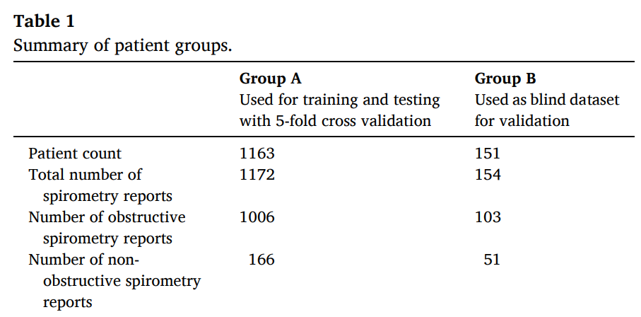
Dataset Attributes

Slide 11
3.3 Creation of ML models
ML models: by using SVM, RF, NB and MLP algorithms
Model training: the spirometry data of patients in Group A(highly imbalanced) with a positive to negative ratio of 6:1
An under-sampling method was used to overcome the imbalance
Two sets of models were trained, one with the whole dataset and one with under-sampled datasets.
Group B dataset was applied to the trained models for external validation
Recursive feature elimination (RFE) was performed using random forest to understand the importance of spirometry features.
Hyperparameter optimization was performed using grid search technique separately for both sets of models
Different ML algorithms have different number of hyperparameters, tuned to improve performance.

Slide 12
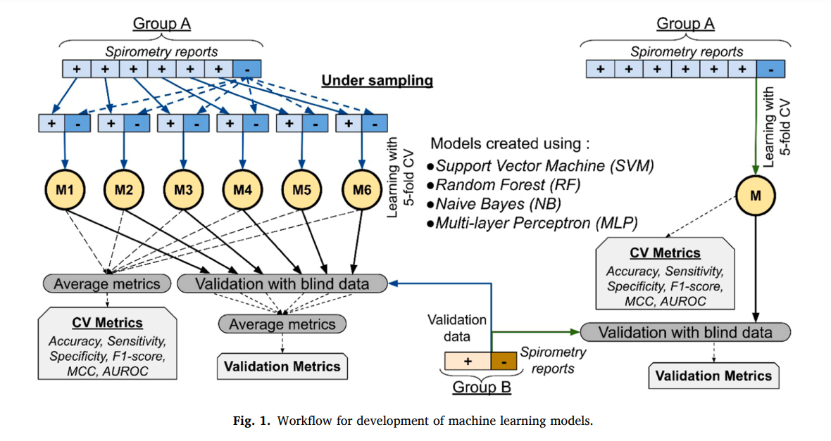
Cont...

Slide 13


3.4 Performance Metrics
Including both threshold-dependent metrics and threshold-independent metrics:
Accuracy: It is the ratio of the number of correctly predicted samples to the number of total samples.
Sensitivity: It is the ratio of the number of correctly predicted positive samples to the number of positive samples.
Specificity: It is the ratio of the number of correctly predicted negative samples to the number of negative samples.
Specificity = TN TN + FP

Slide 14

Cont..
F1-score: It is the harmonic mean of precision and sensitivity.
F1 score = 2 × TP 2 × TP + FP + FN
Matthew’s correlation coefficient (MCC): It is a correlation coefficient whose value is in the range [− 1, + 1].
Area Under Receiver Operator Characteristic curve (AUROC):
The ROC curve plots the sensitivity against (1-specificity) at different thresholds. Area under the ROC curve denotes the probability that a randomly chosen positive sample is ranked higher than a randomly chosen negative sample by the model. (Sensitivity against Specificity)
+1 → Perfect prediction
0 → Prediction that is no better than random choice.
-1 → Inverse prediction

Slide 15
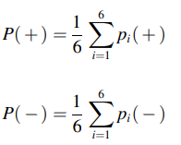
3.5 Development of web app
PulmoPred
The Python instance representing the optimal model was serialized and stored in a web server
User-input facility was implemented as a HTML form
Server-side processing was done using PHP scripts
Data transmission between PHP and Python scripts was done using JSON
The final predicted class and probability are computed by averaging the prediction probabilities of the six under-sampled models
Final predicted class is positive if P(+) > P(-) and negative otherwise.

Slide 16
4. Results

Slide 17
4.1 Results of hyperparameters optimization
Optimal hyperparameters obtained for the SVM models were C=5 and gamma=0.0001
For NB models, the optimal smoothing hyperparameter was obtained as 0
Optimal MLP architecture with two hidden layers (100 nodes followed by 30 nodes) obtained for MLP model trained with whole dataset
Optimal MLP architecture with two hidden layers (100 nodes followed by 100 nodes) obtained for MLP models trained with under-sampled datasets.

Slide 18
cont..
Optimal learning rate was 0.001 for both sets of models
Optimal hyperparameters obtained for RF models trained with under-sampled datasets were: number of trees=20, max depth=4, and max features=0.4
Optimal hyperparameters obtained for RF models trained with the whole dataset were: number of trees=30, max depth=8, and max features=0.7

Slide 19
4.2 Results of 5-fold cross validation
5-fold cross validation was used to evaluate the performance of the models
The specificity of models trained with imbalanced datasets was low
Using under-sampled datasets resulted in an increase in specificity
MLP model showed optimal performance with MCC of 0.68 and accuracy of 83.7%
ROC curves were plotted and AUC was computed, MLP model achieved the highest AUC of 0.91
The accuracy of predicting specific diagnosis was also reported in table 3.
6 features were selected as the most predictive by RFE, MCC score of 0.604 was achieved in classification task.

Slide 20
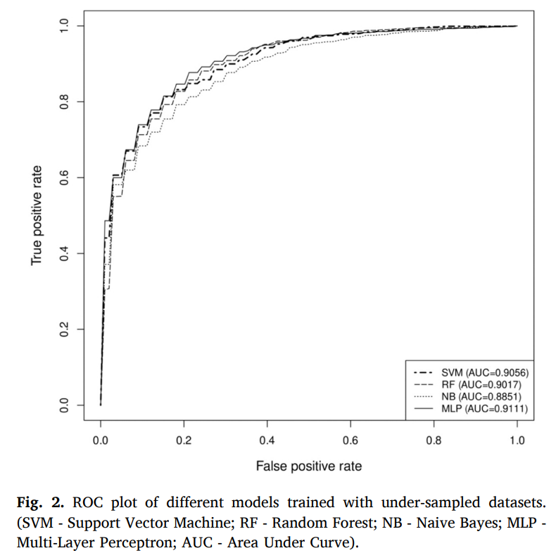
Cont.. (AUROC)

Slide 21
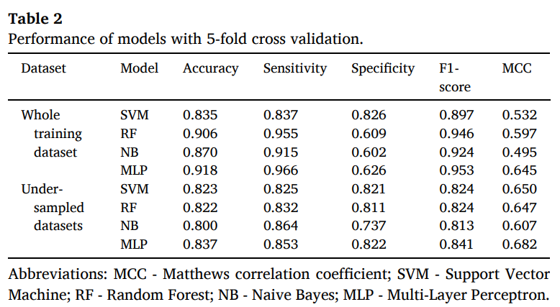
cont..

Slide 22
4.3 Performance on validation dataset
Table 4 shows an increase of accuracy compared to 5-fold cross validation for all models trained with under-sampled datasets
MCC values were similar to that in cross validation
Trend of low specificity persisted for validation dataset prediction with models trained on imbalanced datasets
Table 5 shows the accuracy of predicting spirometry reports of each diagnosis in the blind dataset as either obstructive or non- obstructive by the models.

Slide 23
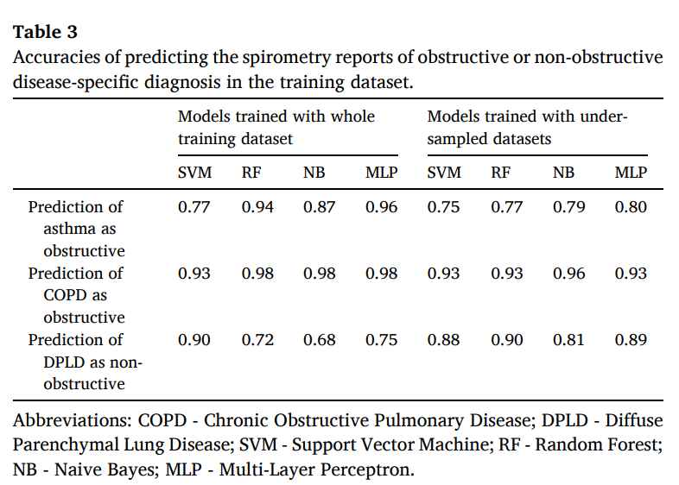
cont..

Slide 24
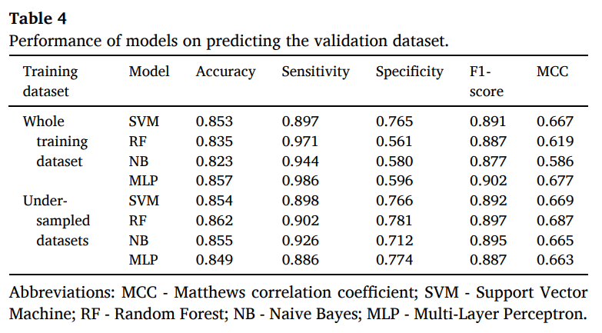
Cont..

Slide 25
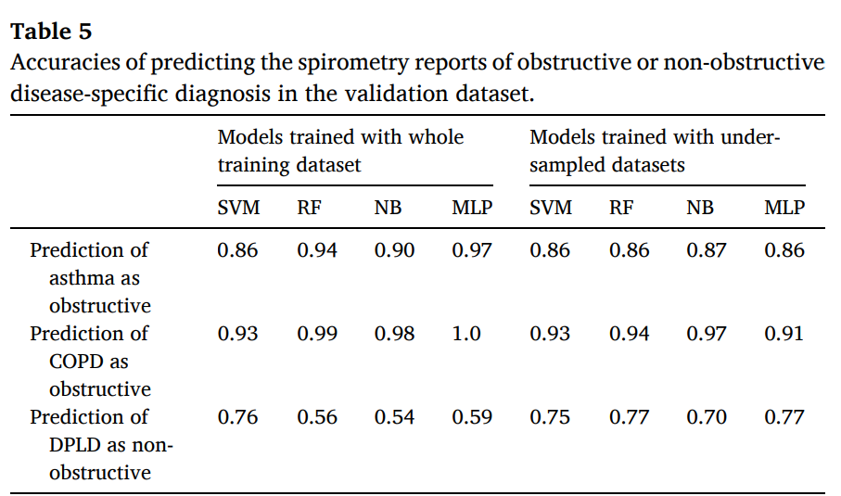
Cont..

Slide 26
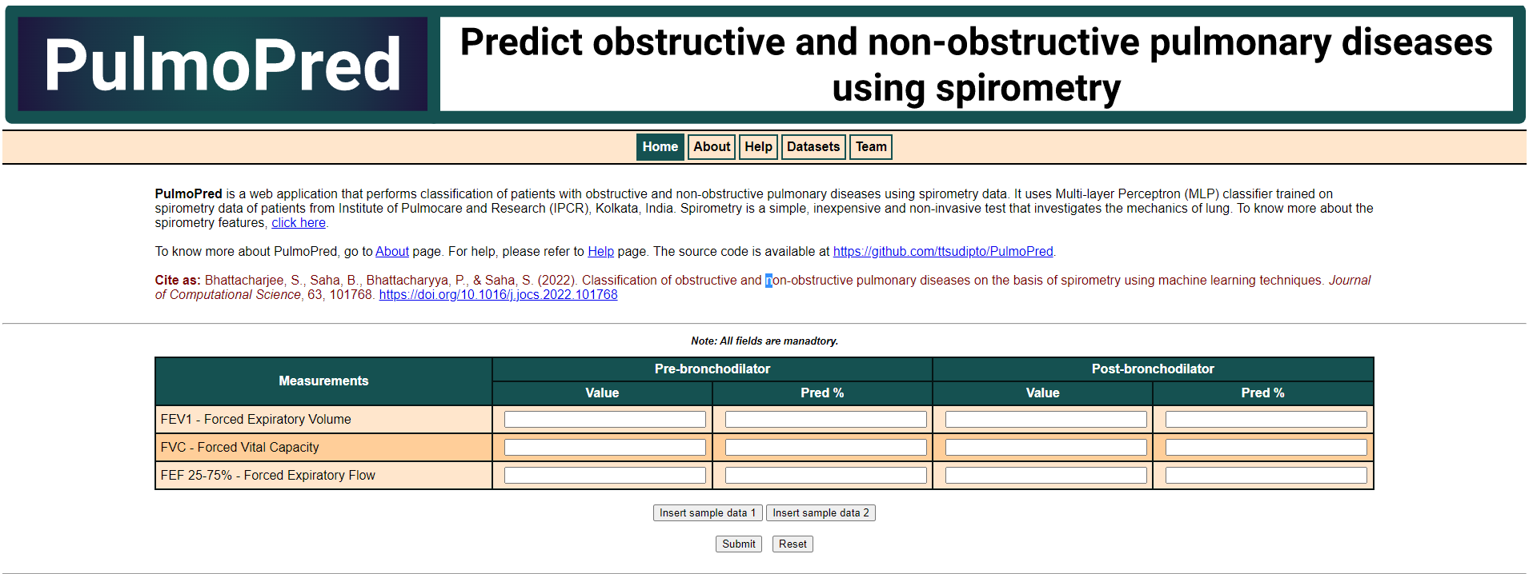
5. Using the web app

Slide 27
Web app (Cont..)
PulmoPred is a web app with a homepage that includes a form with 12 mandatory fields for inputting spirometry values.
There are buttons to insert sample data and a "Reset" button to clear input values.
The "Submit" button performs the prediction task based on the input values.
The output page includes three tables: input values, predicted class label and prediction probability of 6 models, and final predicted class with probability.
A "Help" page is available with more information on the usage of the web application.
Link: http://dibresources.jcbose.ac.in/ssaha4/pulmopred/

Slide 28
6. Discussions
Two sets of models were trained,
(1) Whole dataset (2) Under-sampled datasets.
The whole training dataset was imbalanced, with P:N ratio of 1:6.
The under-sampling approach allowed the models to be trained with balanced datasets.
The models trained with under-sampled datasets performed better, with higher specificity and MCC values.
The models were able to perform disease-specific diagnosis with high accuracy for COPD and DPLD patients(~90%), but not as well for asthma.

Slide 29
Discussions(Cont.)
In the validation phase with a blind dataset, the accuracy of predicting asthma was increased.
Overall performance: with accuracies of ~85%.
The lack of rich enough training data may have caused some performance deterioration.
Obstructive and non-obstructive diseases may co-exist in some patients, leading to wrong diagnostic annotations.
Availability of spirometry reports of patients with non-obstructive diseases was low.
In Future, they can add more non-obstructive diseases data also.

Slide 30
7. Conclusions
In this work, Supervised ML models were created to classify obstructive and non-obstructive pulmonary diseases in patients of eastern India using only 12 attributes of spirometry which is a simple and fairly inexpensive investigation.
Models were created using support vector machine, random forest, Naive Bayes and multi-layer perceptron algorithms.
A web application was developed to serve as an easy-to-use interface for naive users performing the ML-based prediction.

Slide 31
8. References
[1] F. of I.R. Societies, The Global Impact of Respiratory Disease, Second Edi, European Respiratory Society, Sheffield, 2017.
[2] A.S. Buist, Similarities and differences between asthma and chronic obstructive pulmonary disease: treatment and early outcomes, Eur. Respir. J. Suppl. 39 (2003) 30s–35s
[3] R. Gilbert, J.H. Auchincloss, What is a “restrictive” defect? Arch. Intern. Med. 146 (1986) 1779–1781, https://doi.org/10.1001/archinte.1986.00360210165023. [4] R.O. Crapo, Pulmonary-function testing, N. Engl. J. Med. 331 (1994) 25–30, https://doi.org/10.1056/NEJM199407073310107.
[5] I. Pino Pena, ˜ V. Cheplygina, S. Paschaloudi, M. Vuust, J. Carl, U.M. Weinreich, L. R. Østergaard, M. de Bruijne, Automatic emphysema detection using weakly labeled HRCT lung images, PLoS One 13 (2018), e0205397, https://doi.org/ 10.1371/journal.pone.0205397.
[6] D. Bermejo-Pel´ aez, S.Y. Ash, G.R. Washko, R. San Jos´e Est´epar, M.J. LedesmaCarbayo, Classification of interstitial lung abnormality patterns with an ensemble of deep convolutional neural networks, Sci. Rep. 10 (2020) 338, https://doi.org/ 10.1038/s41598-019-56989-5.
[7] N.R.S. Parveen, M.M. Sathik, Detection of pneumonia in chest X-ray images, J. Xray. Sci. Technol. 19 (2011) 423–428, https://doi.org/10.3233/XST-2011- 0304.
[8] P. Lakhani, B. Sundaram, Deep learning at chest radiography: automated classification of pulmonary tuberculosis by using convolutional neural networks, Radiology 284 (2017) 574–582, https://doi.org/10.1148/radiol.2017162326.
[9] P.-H. Feng, Y.-T. Lin, C.-M. Lo, A machine learning texture model for classifying lung cancer subtypes using preliminary bronchoscopic findings, Med. Phys. 45 (2018) 5509–5514, https://doi.org/10.1002/mp.13241.

Slide 32

Thank you for your support !!

